Slide 1
Capstone Engagement
Assessment, Analysis, and Hardening of a Vulnerable System

Slide 2
Table of Contents
This document contains the following sections:
01
Network Topology
02
Red Team: Security Assessment
03
Blue Team: Log Analysis and Attack Characterization
Hardening: Proposed Alarms and Mitigation Strategies
04

Slide 3
Network Topology
‹#›

Slide 4
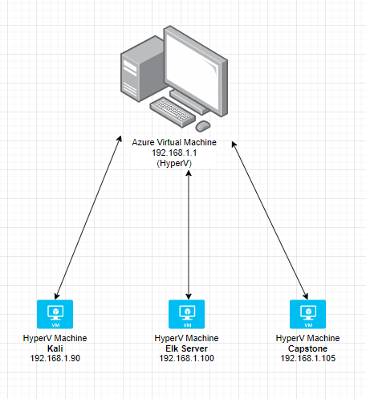
Network Topology
Network
Address Range:192.168.1.1/24
Netmask: 255.255.255.0
Gateway:192.168.1.1
Machines
IPv4:192.168.1.1
OS: Windows XP SP2
Hostname: VirtualPC
IPv4: 192.168.1.90
OS: Linux
Hostname: Kali
IPv4: 192.168.1.100
OS: Linux
Hostname: Elk Server
IPv4: 192.168.1.105
OS: Linux
Hostname: Capstone

Slide 5

Red Team
Security Assessment
‹#›

Slide 6
Recon: Describing the Target
Nmap identified the following hosts on the network:
Hostname | IP Address | Role on Network
Azure Virtual PC | 192.168.1.1 | Provides the HyperV environment for the other 3 virtual machines to run on
Kali | 192.168.1.90 | Red team attacking
Elk Server | 192.168.1.100 | Kibana database / monitoring all network activity
Capstone | 192.168.1.105 | Target machine for the attack

Slide 7
Vulnerability Assessment
The assessment uncovered the following critical vulnerabilities in the target:
Vulnerability | Description | Impact
PHP Login | There are no login lockouts or login attempt regulations | This allows a hacker the ability to continue attempting to login until the user name and password is guessed (Bruteforce)
User information is in plaintext on the server | A user’s password hash is listed in plain text on one of the webpages | This allows an attacker to decrypt the hash to learn the users password and log into the webdav server (Access for planting backdoors in the server)
Sensitive folders available via website | Secret_folder and connect_to_corp_server are both available via website | Unauthorized users can gain access to the data

Slide 8
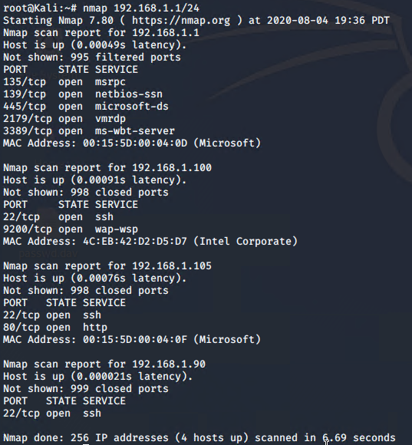
Exploitation: Enumeration
01
02
03
Tools & Processes
Utilized nmap to enumerate and map the target network.
Achievements
Provided information on all 4 computers used in the network to include ip addresses, mac addresses, operating systems, and potential vulnerablitites.

Slide 9
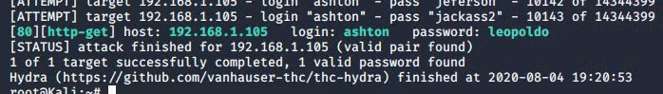
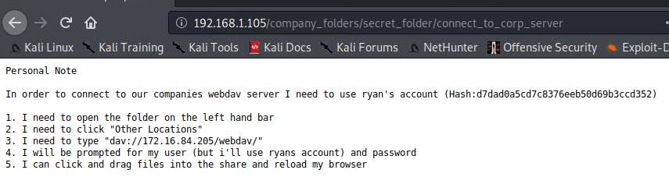
Exploitation: Brute Force HTTP(S)
01
02
03
Tools & Processes
Utilized Hydra to brute force the hidden directory on the website.
Achievements
Gained access to unencrypted data including a password hash for user Ryan.

Slide 10
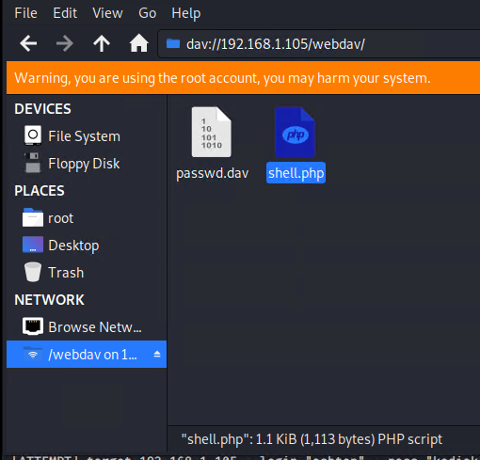
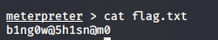
Exploitation: Reverse Shell with Payload
01
02
Tools & Processes
Utilized WebDev with compromised user names and passwords to place a file on the target machine to gain access
Achievements
Gained full access to target machine and located flag.txt file.

Slide 11

Blue Team
Log Analysis and Attack Characterization
‹#›

Slide 12
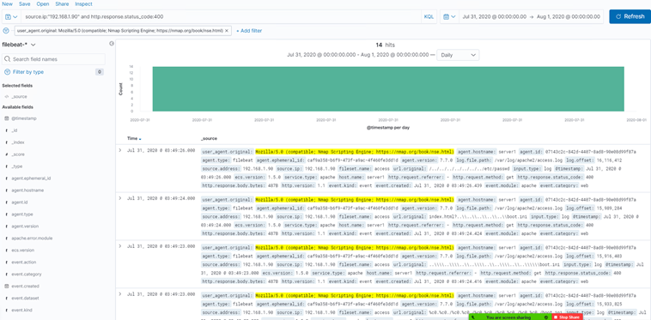
Analysis: Identifying the Port Scan
What time did the port scan occur? 7/31/2020 03:49:26
How many packets were sent, and from which IP? 192.168.1.90
What indicates that this was a port scan? Nmap

Slide 13
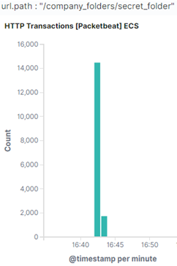
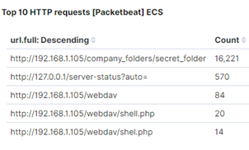
Analysis: Finding the Request for the Hidden Directory
What time did the request occur? 16:42 How many requests were made? 16221
Which files were requested? What did they contain? /company_folders/secret_folder

Slide 14
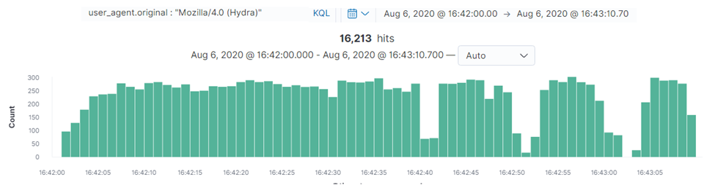
Analysis: Uncovering the Brute Force Attack
How many requests were made in the attack? 16, 213
How many requests had been made before the attacker discovered the password? 16221

Slide 15
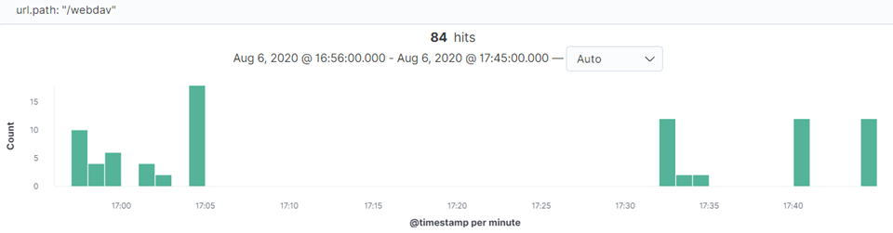
Analysis: Finding the WebDAV Connection
How many requests were made to this directory? 84
Which files were requested? /webdav/shell.php

Slide 16
Blue Team
Proposed Alarms and Mitigation Strategies
‹#›

Slide 17
Mitigation: Blocking the Port Scan
What kind of alarm can be set to detect future port scans?
Set up an Intrusion Detection system and anomaly Detection system alarm which can detect the network scanned with TCP, UDP, etc.
What threshold would you set to activate this alarm?
The threshold sets up at 2-5 times of scanning would trigger alarm.
What configurations can be set on the host to mitigate port scans?
Block incoming ICMP & configure firewall connection with ‘close’ or ‘open’ ports. Update the latest patches of the network .
Describe the solution. If possible, provide required command lines.
Nmap scan for open port and immediately fix the vulnerability for possible to access the system by the open port. Nmap -T4 -sS -sC target-ip

Slide 18
Mitigation: Finding the Request for the Hidden Directory
What kind of alarm can be set to detect future unauthorized access?
Intrusion Detection System and network intrusion detection are the ideal alarms for detecting unauthorized access.
What threshold would you set to activate this alarm?
The threshold can be setted as 5-10 times to trigger the alarm
What configuration can be set on the host to block unwanted access?
Update the latest patches and validated user’s input validation.
Describe the solution. If possible, provide required command lines.
Least privilege for the administrator that cannot be able to access CEO’s information.

Slide 19
Mitigation: Preventing Brute Force Attacks
What kind of alarm can be set to detect future brute force attacks?
Intrusion Detection system and Intrusion prevention system can detect brute force attacks and analyze the attack by the logs
What threshold would you set to activate this alarm?
The threshold sets at 50 times in 1 mins for login attempts.
What configuration can be set on the host to block brute force attacks?
Account lockout, limitation of attempt, enable CAPTCHA verification.
Describe the solution. If possible, provide the required command line(s).
Allow the minimum amount of login and maximum amount of login. For example, 3 times is minimum and 5 times is maximum for a user trying to login

Slide 20
Mitigation: Detecting the WebDAV Connection
What kind of alarm can be set to detect future access to this directory?
Intrusion Detection System and network intrusion detection are detecting directory and files that is modified or remove.
What threshold would you set to activate this alarm?
The threshold would trigger after 5 times failure of login in 1 mins.
What configuration can be set on the host to control access?
Don’t store sensitive information in the web root folder; least privilege
Describe the solution. If possible, provide the required command line(s).
Administrator should not post the password even with hashes and steps how to access the company’s webserver.

Slide 21
Mitigation: Identifying Reverse Shell Uploads
What kind of alarm can be set to detect future file uploads?
IDS also detect the reverse shell program that the attacker deploy in target system
What threshold would you set to activate this alarm?
Set file Size threshold if the file upload size is over the maximum file size, the it will trigger the alarm
What configuration can be set on the host to block file uploads?
Least privilege
Filter out specific file extension
Malware prevention(AV)
Describe the solution. If possible, provide the required command line.
User authentication for upload or download.

Slide 22
???

Slide 23
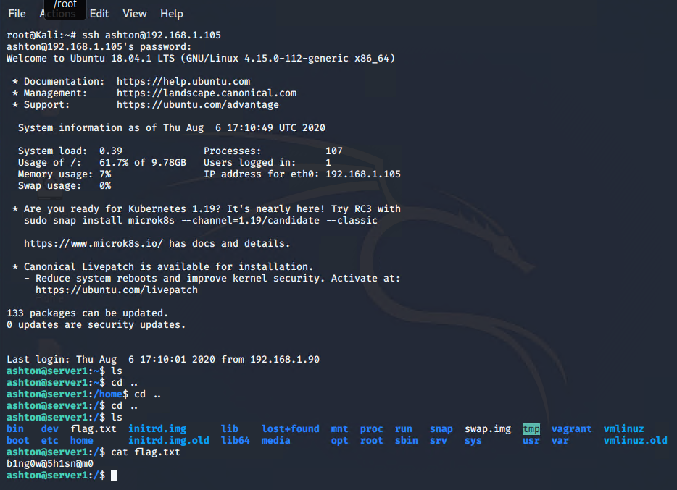
Take the red pill and work outside the rules….
01
02
03
Tools & Processes
SSH
Achievements
Logged in to target machine via SSH connection using Ashton’s credentials and located flag.txt in the root directory.

